Slide 1
Long-Term Growth Trends in the S&P 500 Index
Name: Tahity Abdullah
Course: BSAN 360
Date: December 4, 2025
GitHub Repository: https://github.com/tahity18/BSAN-360-Project

Slide 2
Table of contents
01
02
03
04
05
Data Overview
Hypotheses
Visualization
Results
Conclusion

Slide 3
01
Data Overview

Slide 4
Dataset Description
Dataset: S&P 500 Historical Data
Source: Kaggle — “S&P 500 Historical Data”
https://www.kaggle.com/datasets/henryhan117/sp-500-historical-data
Raw Size: ~23,323 daily observations, 7 variables
Date Range: 1927–2024
Variables included: Date, Open, High, Low, Close, Adj Close, Volume
Main variable used: Adjusted Closing Price, because it accounts for corporate actions (splits, dividends) and best reflects true market value

Slide 5
Descriptive Statistics
 | Open | High | Low | Close | Adj Close | Volume
count | 23323 | 23323 | 23323 | 23323 | 23323 | 23323
mean | 487 | 490 | 484 | 487 | 487 | 7.69E+08
std | 726 | 730 | 722 | 726 | 726 | 1.48E+09
min | 4.4 | 4.4 | 4.4 | 4.4 | 4.4 | 0.0
25% | 24 | 24 | 24 | 24 | 24 | 1.28E+06
50% | 100 | 100 | 99 | 100 | 100 | 1.73E+07
75% | 834 | 844 | 823 | 835 | 835 | 5.38E+08
max | 3565 | 3588 | 3535 | 3581 | 3581 | 1.15E+10

Slide 6
Final Dataset For Analysis
After cleaning and preparation, the final dataset used for analysis includes:
Rows: 35,000+ daily
Columns:
Adj Close
Year
Decade
Log_Close
Time span: 1927–2024 (97 years)
Fully cleaned, consistent daily time series
No missing values in analysis variables

Slide 7
02
Hypotheses

Slide 8
Research Question
How has the long-term growth rate of the S&P 500 evolved over time, and do annual and decade-level patterns reveal statistically significant differences in market performance?

Slide 9
Time Trend vs. Decade Variation
Regression
Anova
H₀ (Null)
The mean adjusted closing price is the same across all decades.
(μ₁ = μ₂ = μ₃ = …)
H₀ (Null)
There is no relationship between time and the log of the S&P 500 adjusted closing price.
H₁ (Alternative)
There is a significant upward relationship between time and log price.
H₁ (Alternative)
At least one decade’s mean adjusted closing price differs from the others.
(Not all μ are equal)

Slide 10
03
Visualization

Slide 11
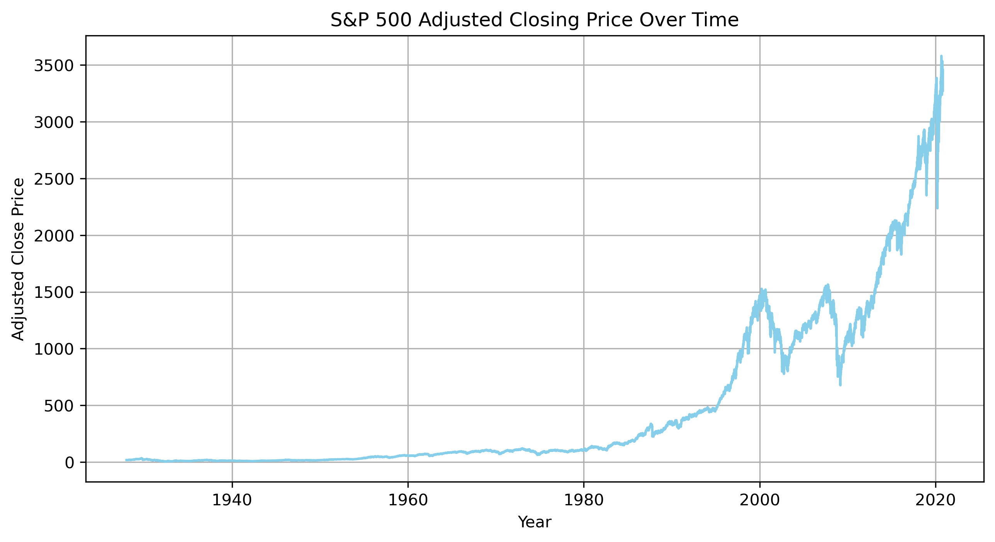
Full Period Trend
Key Insights
Long-term exponential growth from 1927 to 2025
Clear structural breaks around:
Great Depression (1930s)
Dot-Com Crash (2000–2002)
Financial Crisis (2008)
COVID-19 Crash & Recovery (2020+)

Slide 12
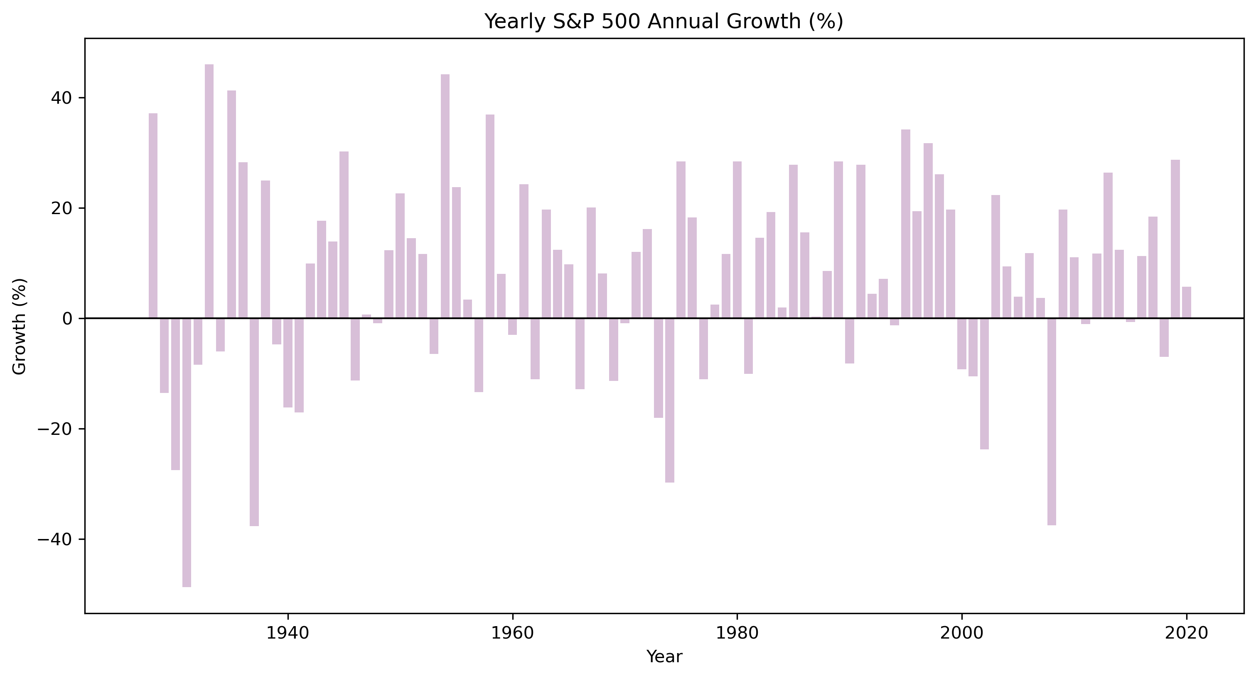
Annual Growth Trend
Key Insights
Highly volatile yearly returns: strong mix of positive and negative years
Largest losses: 1930s, 1970s, 2008, 2020
Long sequences of strong gains: 1950s, 1980s, 2010s
Annual growth is noisy. Supports use of log-trend regression to capture long-term pattern

Slide 13
Decade Level Summary
Decade | Avg_Close | Median_Close | Decade_Volatility
1920 | 23.0 | 22.3 | 4.0
1930 | 12.6 | 11.7 | 4.3
1940 | 13.2 | 13.3 | 2.8
1950 | 35.5 | 35.4 | 12.7
1960 | 79.5 | 82.3 | 14.9
1970 | 96.6 | 98.8 | 10.7
1980 | 198.6 | 170.4 | 72.1
1990 | 653.3 | 473.0 | 321.2
2000 | 1187.3 | 1190.2 | 198.0
2010 | 1962.6 | 1986.5 | 588.9
2020 | 3140.0 | 3236.3 | 283.3
Mean price, median price, and volatility all rise dramatically over decades
Volatility spikes in modern decades (1990s–2020s)
Decades show structured differences, motivating formal testing (ANOVA)

Slide 14
04
Results

Slide 15
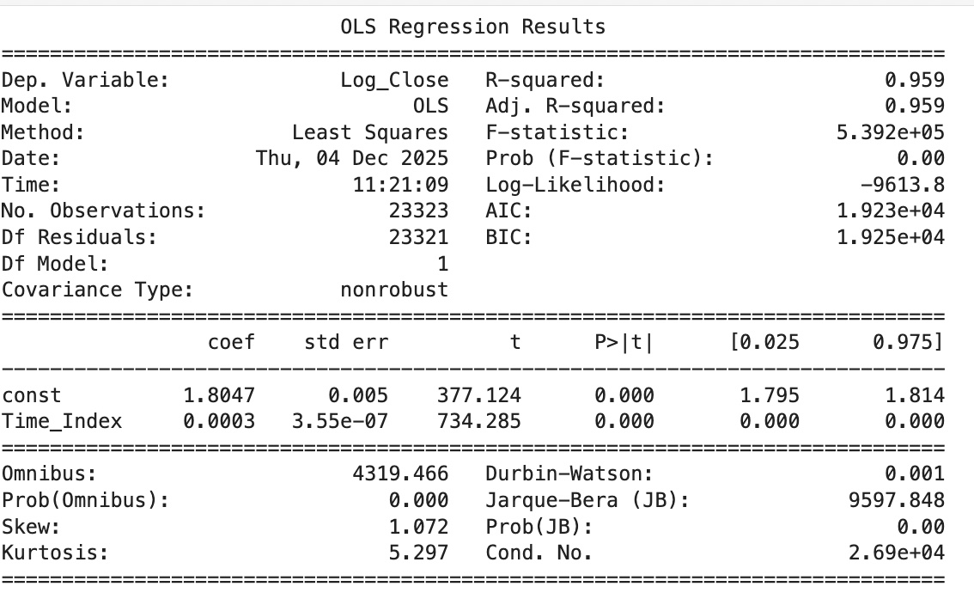
Regression Results
Model: log(Adj Close) ~ Time_Index
Slope: 0.0003 (p < 0.001) → highly significant R² = 0.959 → time explains ~96% of long-term trend Converted annual growth ≈ 7.8% per year, consistent with historical market research Interpretation: The S&P 500 exhibits a strong, statistically significant long-term upward growth trend

Slide 16
Anova Results
ANOVA: Price Variation Across Decades
Results: F = 20,374.85, p = 0 Reject the null hypothesis; decades do not share the same mean price level. Early decades (1920s–1950s) show much lower averages, while recent decades (2000s–2020s) have sharply higher prices and greater volatility. Confirms that S&P 500 growth is uneven across historical eras and aligns with regression findings on long-term upward trends.

Slide 17
05
Conclusion

Slide 18
Overall Findings
Insights
Conclusion
Recommendations
The S&P 500 demonstrates strong, consistent long-term growth with an average annual trend near historical market benchmarks.
Annual growth is volatile, but long-run trend is smooth and upward.
Decade-level analysis shows clear structural differences between economic eras.
The S&P 500 is characterized by exponential long-run growth despite short-term volatility.
Market structure has changed significantly over decades, with rising returns and rising volatility.
Long-term investors benefit from holding over multiple decades rather than reacting to annual volatility.
Favor long-term, buy-and-hold strategies over short-term timing.
Use decade-level analysis to understand macro-trends rather than focusing on yearly noise.
Use log-transformed or return-based models when conducting long-term financial forecasting.

Slide 19
Thanks!

